Slide 1
INTRODUCTION TO ELECTRONICS HIGH LEVEL DESIGN

Slide 2
Agenda
High Performance Computing
History of Electronics Design Description Techniques
Semiconductors choices for computational workloads
Comparison of RTL vs High Level Design Techniques
HLS vs OpenCL
Labs

Slide 3
HIGH PERFORMANCE COMPUTING

Slide 4
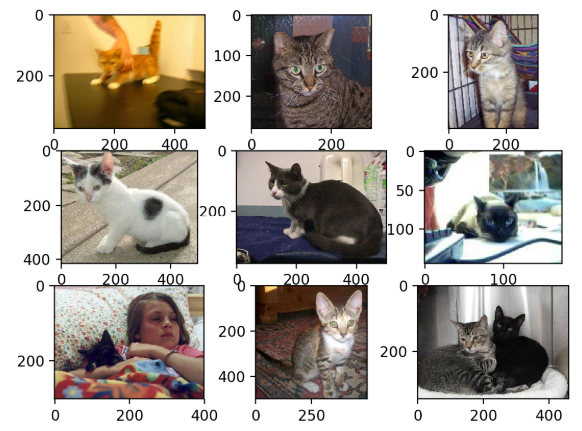
What is meant by a HPC workload?
High-performance computing (HPC) is the use of parallel processing for running advanced application programs efficiently, reliably and quickly. The term applies especially to systems that function above a teraflop or 10¹² floating-point operations per second ^{(definitions may vary)}
Assuming 3 cycle per multiplication operation on a 3 GHz processor. A single threaded processor can produce 1 new multiplication product every 1 billionth of a second. Sound like a lot ? Hmmm, maybe not?
A 2012 ImageNet classification algorithm* takes a 256x256 pixel image and classifies it against 1000 categories that the image might map to. This (unoptimized) algorithm takes 12.2 trillion multiplies! With a single multiply product every 1 billionth of a second, it would take 12,200 seconds to categorize (3 hrs, 24 minutes) at one multiply every one billionth of a second.
*https://vast.cs.ucla.edu/sites/default/files/publications/CNN_ICANN14.pdf

Slide 5
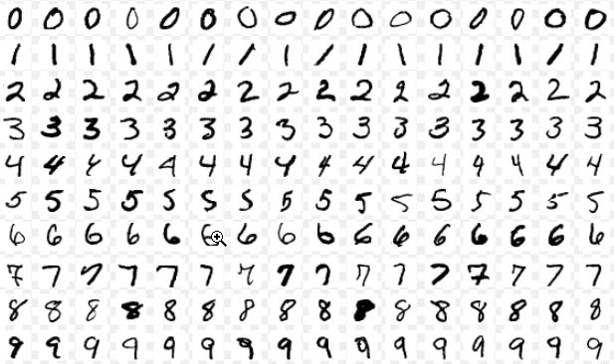
MNIST Example
Modified National Institute of Standards and Technology database
Large database of handwritten digits used for image recognition – researchers study this data set for optimal algorithmic solution
Video explaining handwriting recognition

Slide 6



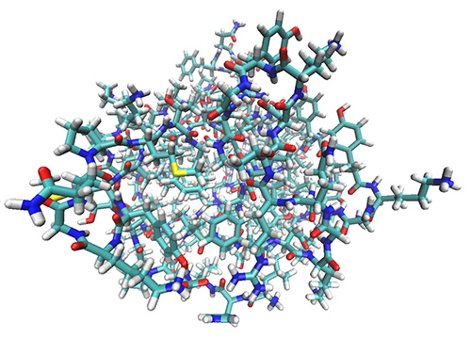




Common High Performance Computing Workloads
Astrophysics
Genomics / Bio-Informatics
Artificial Intelligence
Molecular Dynamics*
Big Data Analytics
Financial
Weather & CLimate
Cyber Security
* Source: https://comp-physics-lincoln.org/2013/01/17/molecular-dynamics-simulations-of-amphiphilic-macromolecules-at-interfaces/
Notes:
Typical workloads that are common today range across many different vertical markets such as life sciences, astrophysics, genomics and bio-informatics, molecular dynamics weather and climate prediction. Artificial intelligence crosses many industries and isone of the hottest topics today. Cyber security and financial analysis are also popular. The rest falls into the big data analytics umbrella which really is a lot of things to a lot of people.

Slide 7
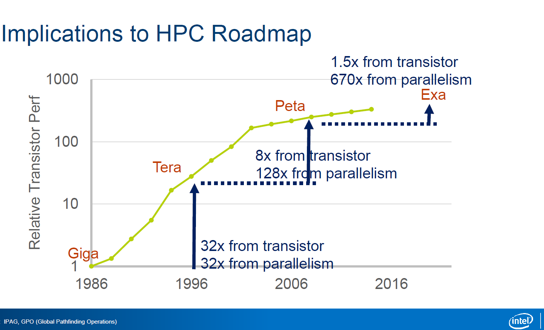
50 GFLOPS/W
~100MW
Notes:
Putting that quote another way, we aren’t getting the required jump in performance necessary to solve tomorrows problems and reach an exascale machine with just Moore’s law. Most of the improvements needed are coming from parallelism. Of course, we have to be careful to recognize the power efficiency of that compute or it becomes unusable. To put it in perspective, at 50GFLOPs/W an exascale machine would require 100MW of power.

Slide 8

Challenges Scaling Systems to Higher Performance
Compute Intensive
(not enough ALUs/DSPs)
Memory Intensive (can’t store data)
IO Intensive (lack IO bandwidth)
Result: Slow Performance
Memory
Result:
Slow Performance (high latency)
Result: Excessive power requirements
Bottleneck
Bottleneck
Bottleneck
I/O
System
I/O
Need to think about Compute Offload as well as Input/Output Processing
Notes:
While parallelism within a CPU has become the norm, there are still system limitations that hinder performance efficiency. The first we already mentioned being the power wall and limitations of power to scaling. The others are compute limitations caused by not being able to extract enough parallelism from a single instruction stream to keep the processors architecture efficiently used. The other limitation is memory bandwidth. Memory is a hot commodity that is needed by everything and having to arbitrate for access limits performance. Finally, we have IO intensive applications where latency is key and not being able to get the data in to be processed in the required time means effectively lower system performance. So, when thinking about parallelism, we need to think about offloading some of the compute and leveraging inline processing to help solve this issues and enable scaling systems to much higher levels of performance.

Slide 9

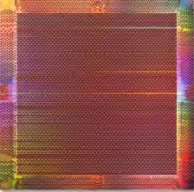
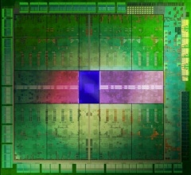
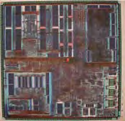
The Intel Vision
Heterogeneous Systems:
Span from CPU to GPU to FPGA to dedicated devices with consistent programming models, languages, and tools
CPUs GPUs FPGAs ASSP
Application Specific Standard Product
Notes:
And that is exactly what Intel’s view is for the future of computing. Enabling heterogenous systems that provide acceleration to the CPU using GPUs, FPGAs and dedicated function ASSP devices….and providing a common front end programming model, language and tool flow to use them.

Slide 10
CPU vs GPU vs ASIC vs FPGA
Device | Ease of Programming | Efficiency | Power
CPU | Easy | Low | Medium-High
GPU | Medium | Medium-High | High
ASIC | N/A | Very High | Low
FPGA | Hard | High | Medium-High

Slide 11
DESIGN ENTRY METHODS

Slide 12
History of Digital Electronic Design Descriptions
Manual Design – Designer manually described each layer
Early ASIC/FPGA CAD – Netlist manual entry / 1st generation place and route
Espresso and other first generation optimizers – truth table reduction
Verilog and VHDL go mainstream
System Verilog and Verification centric methods
High Level Design – abstract away hardware details so that the software community can program ASICs and FPGAs
Verilog
System
Verilog
ASIC/FPGA
CAD
Manual
Catapult C
espresso
VHDL
OpenCL
DPC++
1960
1970
1980
1990
2000
2010
2020

Slide 13
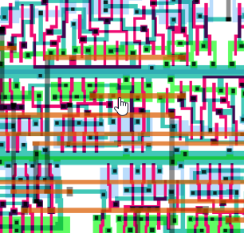
1960s Manual Semiconductor Design
Manually drawn layout and interconnect
Manual checks of design rule checks (DRC)

Slide 14
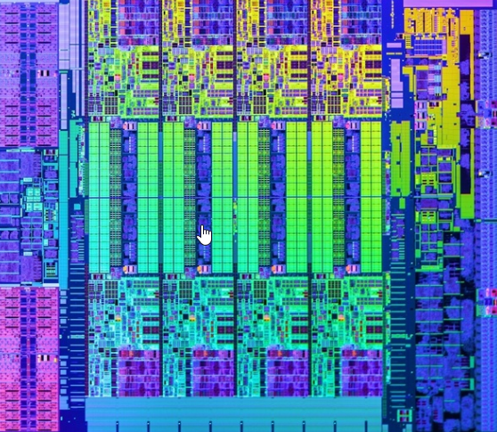
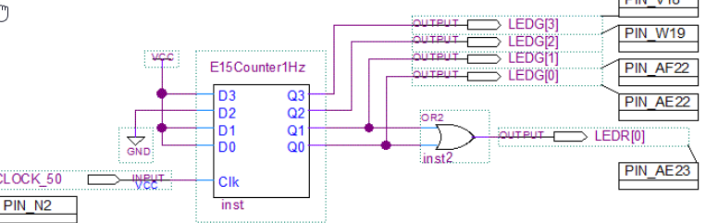
1970s/1980s
Early EDA tools automate error prone and tedious electronic design techniques
Schematic capture
Place and route
Physical design rule checks

Slide 15
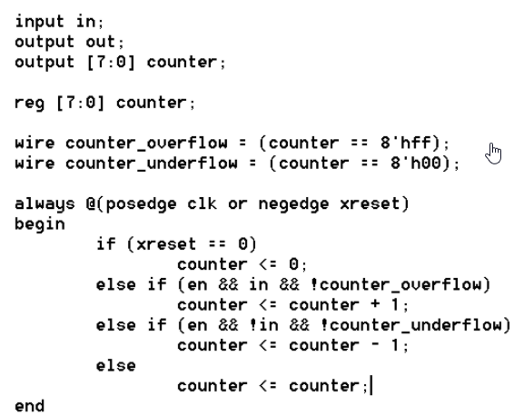
1990s: Hardware Description Languages (RTL) Go Mainstream
VHDL developed through US Dept of Defense
Verilog developed through Silicon Valley startup (Gateway Automation, later acquired by Cadence)
Languages originally used for modelling
Synopsys Design Compiler revolutionized compiling RTL language to gate level description and offered a huge increase in productivity (still primary means to describe electronics)

Slide 16
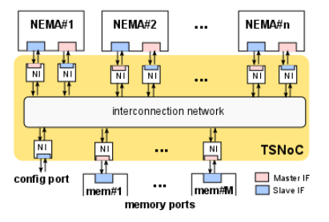
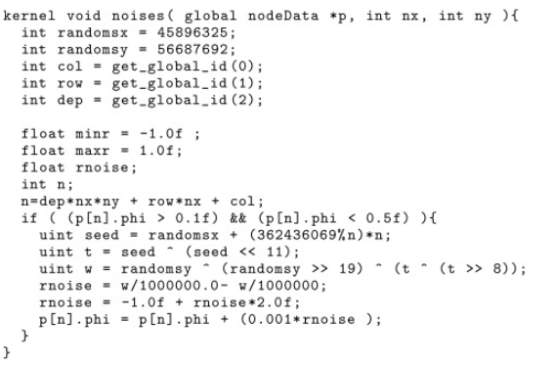
2000-2020
Behavioral descriptions slowly gains popularity (Catapult VC, OpenCL, DPC++) – C derivative languages – RTL still most popular
Network on Chip – GUI based System Integration and IP integration
OpenCL
Network on Chip

Slide 17
Why use C++ based languages for HW design?
RTL design requires deep knowledge in pipelining, parallel architectures
Design and verification of RTL is more time consuming – stimulus requires cycle accurate test vectors
For C++ based (OpenCL, DPC++, HLS) main () becomes the test bench
Far more computer scientists than hardware engineers in universities and industry
High Level Design compilers in general produce slower and less area efficient designs in favor of faster development times

Slide 18
OpenCL
Framework for writing programs across heterogeneous platforms
CPU, GPU, DSP, ASIC, FPGA
Based on C++
Standard Interface for parallel computing
Initiated through Apple, maintained by non-profit company Khronos Group
GPU: CUDA on nVidia, OpenCL on AMD

Slide 19

How languages generate parallel hardware
RTL
always @ (posedge clock) begin
product_1 <= a * b;
product_2 <= c * d;
product_3 <= e * f;
product_4 <= g * h;
end
C++ Based Language
#pragma unroll 4
for (uint i = 0; i < 3; i++) {
uint num1 = first_num_cache[i];
uint num2 = second_num_cache[i];
ulong out_prod = num1 * num2;
out_prod_cache[i] = out_prod;
}
// Specific to OpenCL - ndrange
__kernel void product (__global const float * restrict a,
__global const float * restrict b,
__global float * restrict answer) {
size_t gid = get_global_id(0);
answer[gid] = a[gid] * b[gid];
}
Fine grained parallelism within a kernel
In this case 4 multipliers in parallel
Coarse grained parallelism – good for working on arrays of data (eg video) with no dependencies

Slide 20
Intel Acceleration Stack (IAS)

Slide 21
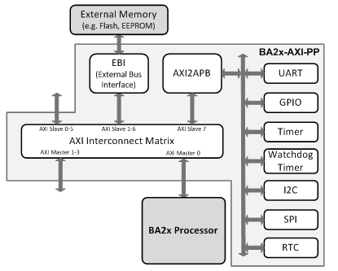
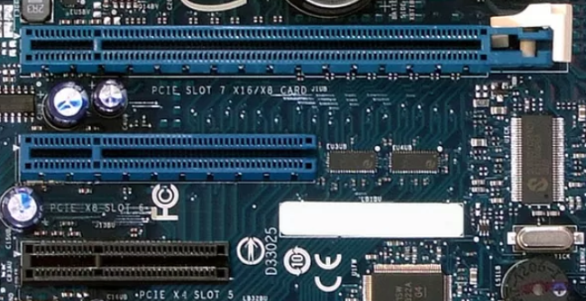
Understanding Connectivity
Bus: Communication system that transfers data between components in a computer, or within an IC
Examples:
PCI Express – Motherboard to peripheral board connectivity
AXI – On-chip connectivity standard (ARM)
Avalon – Simliar to AXI but Intel FPGA specific

Slide 22
What is the Intel Acceleration Stack (IAS)?
Hardware abstraction of physical interfaces
Host interface (e.g. PCI Express)
Memory interface (e.g. DD4-SDRAM)
Network interface (e.g. 10Gbps SFP)
Software abstraction of the hardware
PCIe device driver
Common library for accessing hardware and managing memory

Slide 23
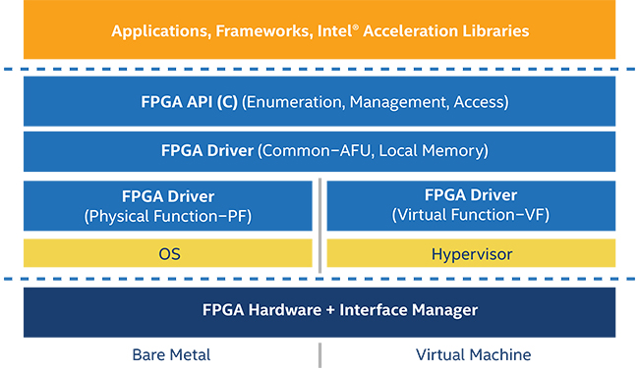
What is the Intel Acceleration Stack (IAS)?
Customers develop user space application
Intel provides software abstraction layer called the “Open Programable Acceleration Engine” (OPAE)
Intel provides hardware abstraction layer called the “FPGA Interface Manager” (FIM)

Slide 24
Why did Intel Create IAS?
Creating an acceleration card is difficult
Need to close timing on external interfaces
Need to create drivers to manage hardware
Products in the server space require stringent verification (stakes too high not to)
Customers can focus their value add
No need to deal with server and card qualification
Focus on creating hardware accelerators on a standard platform
Provides a standard that the industry can get behind to avoid fragmentation
Difficult to port accelerator without a common platform stack

Slide 25
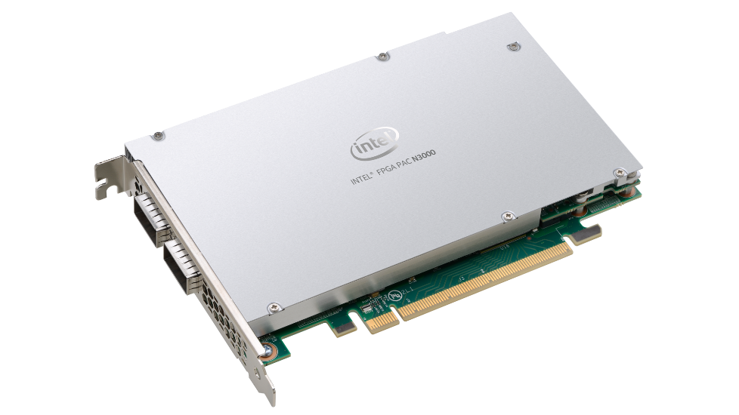
PAC Boards on the Market – N3000
Internally known as “Vista Creek”
Based on Arria 10 GX device
Intended for Network Acceleration Applications
FPGA offloads Intel network controllers
FPGA deals with traffic filtering before Intel NICs see the packets
FPGA implements features Intel NICs lack
Intel NICs provide remainder of features that are already optimally implemented

Slide 26
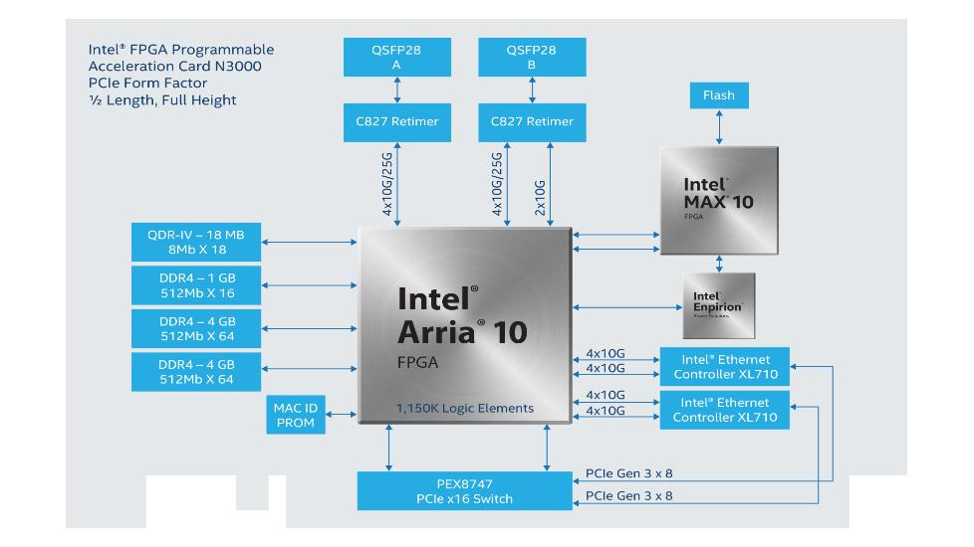
PAC Boards on the Market – N3000
FPGA deals with raw network traffic
Network traffic to/from host forwarded by FPGA and Ethernet controllers

Slide 27
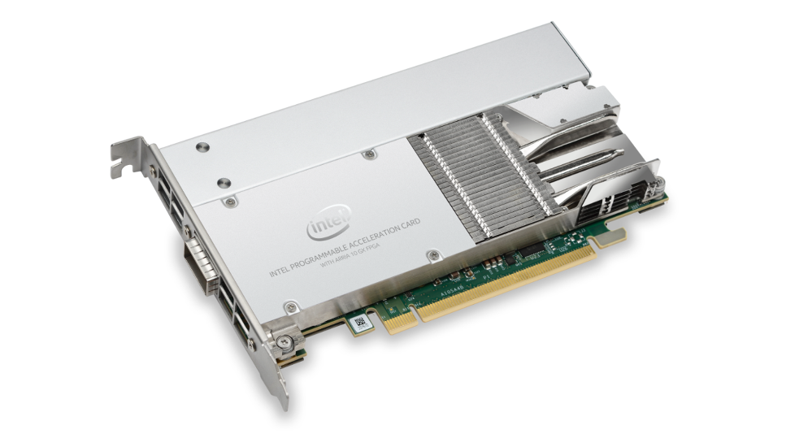
PAC Boards on the Market – Arria 10 PAC
Internally known as “Rush Creek”
First PAC board available to market
Intended for ‘lookaside’ acceleration
Similar to a GPU accelerator
Contains 40Gbps network interface
Compute on network payloads instead of network offload (e.g. financial)
Small formfactor bringing FPGA to servers that GPUs cannot service (won’t fit)

Slide 28
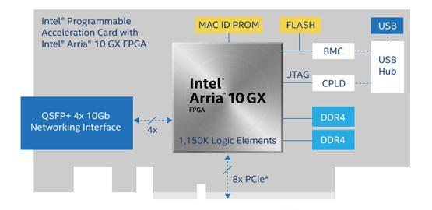
PAC Boards on the Market – Arria 10 PAC
FPGA includes network MAC so that data can be computed without intervention from host
Host data accessed directly by FPGA accelerator

Slide 29
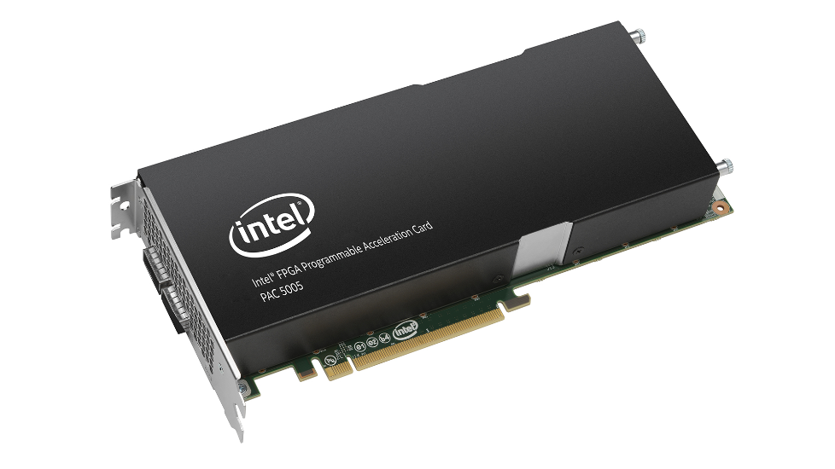
PAC Boards on the Market – D5005
Internally known as “Darby Creek”
Successor to Arria 10 PAC
Based on Stratix 10 SX device
Essentially Rush Creek on steroids
Bigger & faster FPGA
Faster & more external memory
Faster & more network lanes
Double PCIe bandwidth

Slide 30
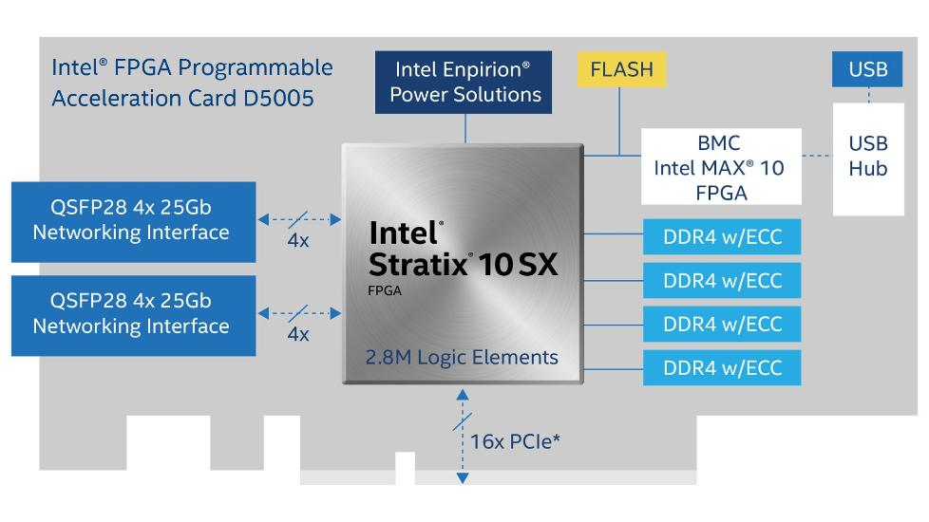
PAC Boards on the Market – D5005
5x bandwidth compared to A10 PAC
2.5x more performance compared to A10 PAC
4x more density compared to A10 PAC
Includes ECC support compared to A10 PAC
Over 2.5x area and faster compared to A10 PAC
2x bandwidth compared to A10 PAC

Slide 31
AFU – FIM Integration

Slide 32
FPGA Interface Manager (FIM)
Loaded in FPGA at boot time
Loaded from flash
Designed by Intel
Customers focus on designing AFU instead
Driver/tools manage FIM
Customers do not need to manage card themselves

Slide 33
Accelerator Functional Unit (AFU)
Designed by customers
Any algorithm they want to implement
Their value add spent here
Accelerators use common interfaces
CCIP bus for host-FPGA communication
External Memory Interface
Network Interface

Slide 34
Open Programmable Acceleration Engine (OPAE)
OPAE comprised of the following
PCIe driver
Tools for reading card status, programming FPGA/flash, controlling FIM
Application APIs for accessing/managing hardware
Provides user space interfaces for customer code to interact with
Managing host buffers accessible to accelerator
Providing bare-metal APIs to access accelerator control/status registers
Framework binding accelerator cards to customer application

Slide 35
OPENCL VS HLS (HIGH LEVEL SYNTHESIS)

Slide 36
Differences in programming model for OpenCL vs HLS
OpenCL (Full chip approach)
Runs as an accelerator to a host processor
Designer does not need to understand hardware design – this is completely abstracted away. Concepts like pipelining or resource allocation. Better optimization happens with HW background.
Intel provides FPGA interfaces with external memory, PCIe and network (Board Support Package)
Programmer writes C++ “like” language with extensions to force parallelism
HLS (block level approach)
FPGA Designer designs all blocks on the FPGA - unlike OpenCL, HLS does not include a board support package
Interfaces can be designed with RTL or IP block generation tools
HLS block plugs into Avalon bus – Intel provides automated tool called Platform Designer that enables automated integration of blocks into the bus

Slide 37
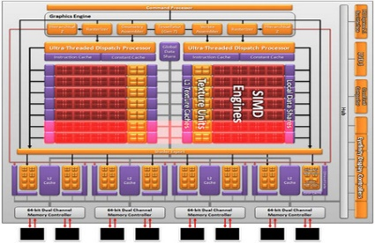
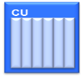

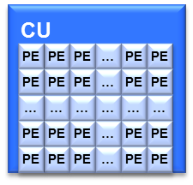
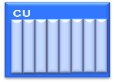

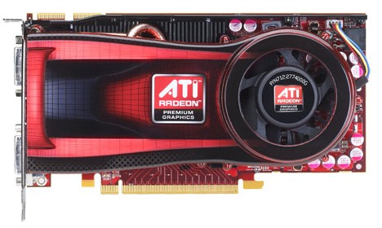
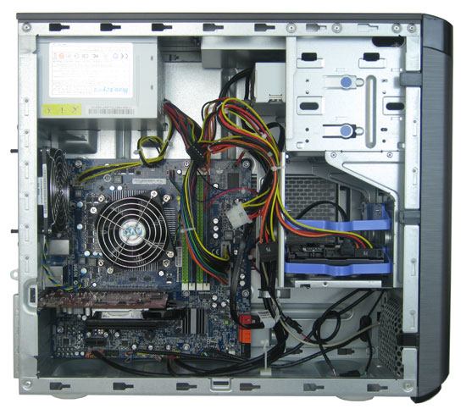
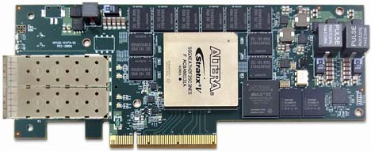
OpenCL Heterogeneous Platform Model
CU = Computational Unit
kernels
OpenCL
Platform
Model
Host Memory
GPU Device
FPGA Device
Host
Global Memory
Example
Platform
x86
PCIe
Notes:
Each of the accelerators has its own structure, the difference being that the GPU’s is fixed.
<CLICK>
The GPU is made up of multiple duplicate compute units which contain lots and lots of processing elements. Where the FPGA will contain as many compute units organized and configured with however many processing elements as needed to perform the acceleration functions that were defined in the OpenCL kernels

Slide 38


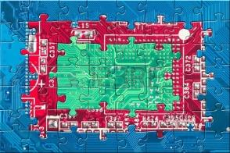
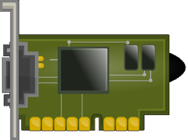

Intel FPGA SW Developer’s Kit for OpenCL™ Flow
OpenCL Host Program
Kernel compiler:
Optimized pipelines from C/C++
Board support package: (created by hardware developer)
Timing closure, pinouts, periphery planning – we’ve got it covered
System integrator: (Quartus runs behind the scenes)
Optimized I/O interconnects
Board Support Package
foo.cl
Compiler
System Integrator
HDL IP Core
FPGA in a System
Notes:
Where HLS builds just a function that still needs to be connected to an existing FPGA system
<click>
OpenCL makes FPGA acceleration available to software developers by building the whole FPGA image automatically. It requires a Board Support package for the particular board being targeted. This was something that an FPGA developer would still need to create as it defines the IO interfaces and effectively turns the FPGA into an ASSP device.
<click>
Then the system integrates the compiled OpenCL accelerator kernel functions with the BSP to build the overall FPGA image that the host program can communicate with using the OpenCL API in the runtime.

Slide 39
HLS Design Flow High Level Synthesis
FPGA Designer designs all blocks - unlike OpenCL, for HLS flow the Board Support Package is not included
Interfaces can be designed with RTL or IP block generation tools
HLS block plugs into Avalon bus – Intel provides automated tool called Platform Designer that enables automated integration of blocks into the bus
DDR
Memory
Interface
USB
Ethernet
component int add(int a, int b) {
return a+b;
}
add
Avalon Internal Bus
start
done
busy
stall
GPIO
HLS Based Accelerator
a[31:0]
b[31:0]
clock

Slide 40
OpenCL vs HLS
Characteristic | OpenCL | HLS
Intended User | Software Developers | Hardware Developers
Software driver and runtime included? | Yes | No
Experience in system design needed? | No – Compilation flow integrates OpenCL kernel into BSP automatically | Yes - user must integrate accelerator into larger system
Experience in IP design needed? | No – Software developers are not expected to write any RTL and just describe algorithm in the OpenCL kernel language | Maybe – Most real designs will use a combination of HLS generated logic and hand coded/3rd party IP
Verification of hardware | Typically accomplished by running data through kernel and original software to verify results match | Typically accomplished by simulating the accelerator with stimulus standalone then in larger system with the remainder of the IP
Accelerator threading model | Multi-thread (NDRange) or single-threaded (Single-threaded work-item) | Single-threaded
Main shortcoming | Compiling OpenCL kernel for FPGA usually takes hours while OpenCL on CPU/GPU compiles < 1 second | Data dependencies in loops can result in efficiencies

Slide 41
HLS (HIGH LEVEL SYNTHESIS)

Slide 42
HLS Use Model
g++ <options>
i++ <options>
src.c
a.exe
C/C++ Code
lib.h
main
f
f
f
t1
f
f11
f12
f13
t2
IP
f21
Directives
f22
f23
FPGA
Standard
gcc/g++ Compiler
HLS Compiler
IP
100% Makefile compatible
EXE
HDL IP
Intel® Quartus® Ecosystem
Notes:
Because it is so much faster to develop in software. The HLS use model allows users to develop and debug the system in the software world and the HLS bridge the gap between the software and hardware worlds, leveraging the productivity flow wherever possible.
First, A user has C/C++code that he or she can compile and verify with a standard gcc/g++ compiler
The output of that is an executable that is run on a host. If there are functions that needs to be accelerated by putting them into the FPGA,
<>
The developer can then compile the same exact c/c++ code with the g++ makefile compatible Intel HLS Compiler.
The resulting output of the compiler is an IP block that that can be integrated with other FPGA logic in the Quartus Ecosystem.
The Intel HLS compiler will also generate a host executable that will automatically cosimulate the IP in a hardware simulator such as Modelsim with the software testbench.

Slide 43
Intel® HLS Compiler Usage and Output
Develop with C/C++:
GDB-Compatible Executable
i++ -march=x86-64 src.c
src.c
a.exe|out
lib.h
Executable which will run calls to func in simulation of synthesized IP
a.exe|out
Run Compiler for HLS:
All the files necessary to include IP in a Quartus project. i.e. .qsys, .ip, .v etc
i++ -march=<fpga fam> -–component func src.c
a.prj/components/func/
src.c
a.prj/reports/
Component hardware implementation reports
lib.h
a.prj/verification/
Simulation testbench
a.prj/quartus/
Quartus project to compile all IP
a is the default output name, -o option can be used to specify a non-default output name
Notes:
This slide shows the usage modes and output of the Intel HLS compiler. As you can see the compiler would produce an executable as we described earlier. and the compiler is makefile compatible with g++.
the Intel HLS Compiler can be run with two machine architecture modes. in the x86-64 mode the compiler works just like g++ compiler. It will compile your source into an executable to be run on the x86 machines, this executable is GDB-compatible and can be used for functional verification.
The second usage mode is to enable march=fpga to run the compiler for HLS. In this mode you’ll use the component argument or component attribute to direct the compiler to create an RTL IP for one or several of the functions in the host code. The compiler will produce the HDL code as well as reports and a testbench x86 executable. The generated executable shown in green on this slide is the testbench executable. In the fpga mode it will actually run calls to your IP function in simulation using an HDL simulator such as Modelsim. It will also generate the a.prj directory which contains 4 different subdirectories. We will talk about each of these in more detail later. THe components subdirectory contains all the files necessary to include the various generated IP in a Quartus project. The reports directory contains component hardware implementation and execution reports. The verification directory contains the HDL simulation testbench to be used in Modelsim. And finally the Quartus directory contains the Quartus project that can compile the generated IPs in Quartus software.
As a note, the default name of the outputs is a, but you can use the -o option to specify a non-default output name of your choice. This is the same behavior as GNU compilers.

Slide 44
HLS Procedure: x86 Emulation
Create Component and Testbench in C/C++
Emulation
Functional Verification with g++ or i++
Use -march=x86-64
Both compilers compatible with GDB
C/C++ Source
Functional
Iterations
Compile with i++ -march=<FPGA fam> for HLS
Generates IP
Examine compiler generated reports
Verify design in simulation
Intel® HLS Compiler
Architectural
Iterations
HDL IP
Run Quartus® Prime Compilation on Generated IP
Generate QoR metrics
Integrate IP with rest of your FPGA system
Notes:
Here's the flow chart for the procedure to use the HLS compiler to convert c++ source into an HDL IP.
First you write your component as a c/c++ function and the testbench in c/c++.
For functional verification you will use the GNU g++ compiler or the i++ compiler with machine arch set to x86-64. The executable here is just a regular software executable to be executed on x86 machines. To debug both the i++ compiler and the g++ can be used with the GDB debugger.
Once the component and testbench has been functionally verified you will move on to the architectural phase of the design by using the i++ compiler with machine architecture set to FPGA. When the i++ compiler is run in the FPGA mode it will generate the HDL IP as well as an x86 executable that will cosimulate your IP with a HDL simulation environment such as the Modelsim Intel FPGA edition.
Once you're happy with the estimated resource consumption as well as execution performance through i++ generated reports, you can compile the generated IP with the Quartus prime software to verify the Quality of Results metrics as it would fit on the FPGA.
Lastly you can use HDL or Qsys in the Quartus software ecosystem to integrate the IP with the rest of your FPGA design.

Slide 45
HLS LAB

Slide 46
Todays Lab
Use HLS C++ to derive the floor square root of a 32 bit integer – integer number that is <= real square root
Algorithm – take ½ of the input and test if the square of that number is greater, less than or equal to the input.
If equal, exact square root is found, return answer
If answer ^ 2 > input, try answer-1 / 2, square it and try again
If answer ^ 2 < input, try answer+1 / 2, square it and try again
Iterate until closest number <= actual answer is found

Slide 47
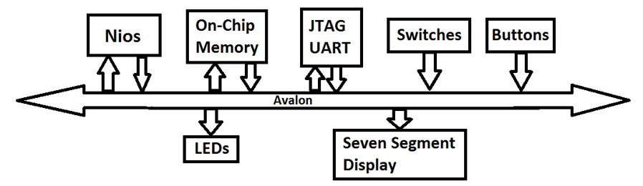
Connectivity to the Avalon bus
Recall HLS builds an Avalon slave device. We will use NIOS based Platform Designer system as a starting point
HLS based sqrt

Slide 48
Traditional System Design
Processor
(32-bit Master)
PCI Express
(64-bit Master)
Lots of wires !
Error prone to get working !
Bus Interface
Interrupt Controller
Bus Interface
Address
Decoder
Address
Address
Data
Arbiter
Data
Width Adapter
Width Adapter
Width Adapter
Width Adapter
Width Adapter
Bus Interface
Bus Interface
Bus Interface
Bus Interface
Bus Interface
Slave 1 8-Bit
Slave 2 32-Bit
Slave 3 16-Bit
Slave 4 32-Bit
Slave 5 64-Bit
Components may use different interfaces to communicate (some standard, some non-standard)
Significant engineering work required to design custom interface logic
Integrating design blocks and intellectual property (IP) is tedious and error-prone
Notes:
System design can be difficult process. Here is an example of a typical system. You have different devices in your system that have different interfaces that need to communicate in order for the system to work. This requires a lot of engineering effort to design custom interface, or glue, logic to enable this communication including things like arbitration and width matching. This type of logic does not add a lot of value, it is just necessary to get the system connected. Putting this together is a naturally error-prone process as the designer has to resolve the various data, control and status signals between the different interfaces as well as the timing of these signals.

Slide 49
Automatic Interconnect Generation
Processor
(32-bit Master)
PCI Express
(64-bit Master)
Bus Interface
Interrupt Controller
Bus Interface
Address
Decoder
Address
Address
Data
Arbiter
Data
Platform Designer automatically
generates interconnect
Width Adapter
Width Adapter
Width Adapter
Width Adapter
Width Adapter
Bus Interface
Bus Interface
Bus Interface
Bus Interface
Bus Interface
Slave 1 8-Bit
Slave 2 32-Bit
Slave 3 16-Bit
Slave 4 32-Bit
Slave 5 64-Bit
Avoids error-prone integration
Saves development time with automatic logic & HDL generation
Enables you to focus on value-add blocks
Platform Designer improves productivity by automatically generating the system interconnect logic
Notes:
When you use Qsys to design your system, Qsys generates a custom-built interconnect structure that facilitates communication between all of your system components. Again, this abstracts away from the designer the manual process of manipulating interconnects and signals and allows them to instead focus on integrating system blocks.

Slide 50

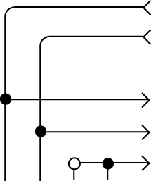

Easy-to-Use System Integration UI
Catalog of
available IP
Connect custom IP and systems
Interface protocols
Memory
DSP
Embedded
Bridges
PLL
Custom systems
IP 1
Custom 1
IP 2
IP 3
Custom 2
Accelerate development
Simplify integration
HDL
Automate error-prone integration tasks
Notes:
Qsys facilitates designing at a higher level of abstraction by providing an easy-to-use UI for system integration. For example, there is the Component Library from which you can select IP and sub-systems to add to your system. There is also a Connection panel that lets you quickly and easily connect IP and subsystems together. Again, the goal to build systems at a higher level of abstraction than manually writing code.

Slide 51
Verification: HLS code, RTL, hardware
C++ based testbench (main)
C++ based testbench (main)
Nios C code running on HW
HLS
RTL
Avalon Nios based system

Slide 52
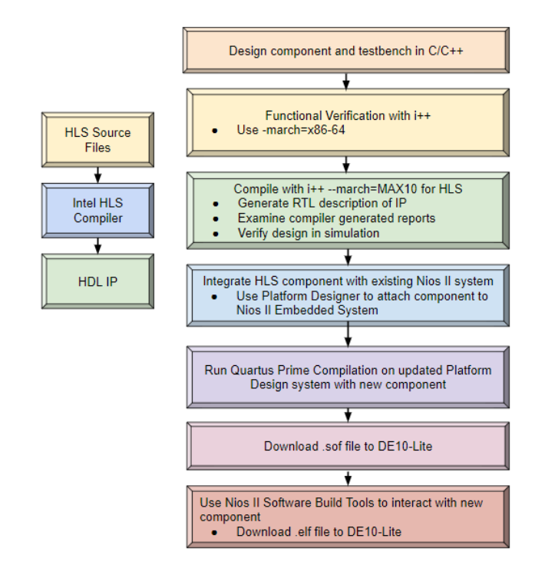
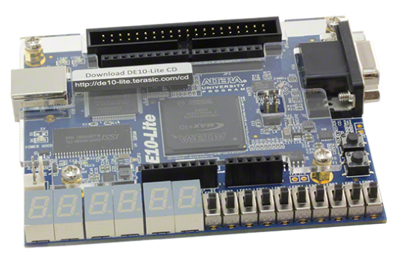
Overall Flow – HLS Lab
i++ (emulation)
i++ (compilation)
Eclipse
C Compiler
Modelsim
(simulation)
Eclipse
Download ELF
Quartus
Platform Designer
Quartus
Synthesis/Fitter/
Assembler
Quartus
Programmer

